Slide 1
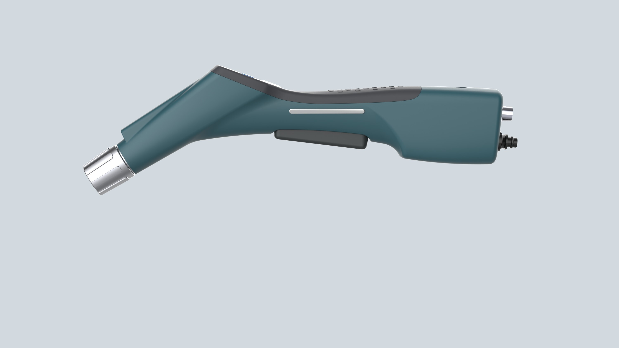
Finalized Wand UI Concept 14 Oct 2020

Slide 2



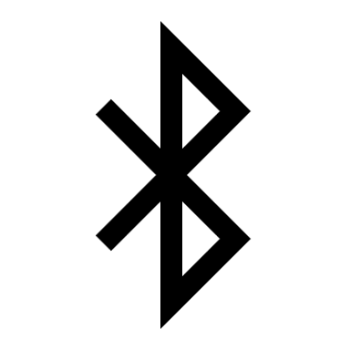

Final Wand UI Concept 14 Oct 2020
Battery Status Indicator
4 LED Segments
(Example icon shown with 3 of 4 segments illuminated) 4 Green LEDS = 100% 3 Green = 75%
2 Yellow = 50%
1 Red = 25%
1 Flashing Red < 5%
Spray Status Indicator
Single bicolor LED Green: Spraying
Red: System Error
Toggle Electrostatic
(membrane button)
On – Green
Off – Flashing Red (reminder)
Toggle Bluetooth
(membrane button)
On – Blue & Paired
Off – Blank & No Pairing
Discovery – Flashing Blue
43mm
(ref)
Note: Electrostatic and Bluetooth button have a pad printed membrane with strong tactile feedback and an internal LED
Trigger Lock
(Physical Button w/ LED Illumination)
Off – Green (default ready to spray)
On – Red (trigger cannot spray)
~30% bigger surface area as used more often
37mm (ref)

Slide 3
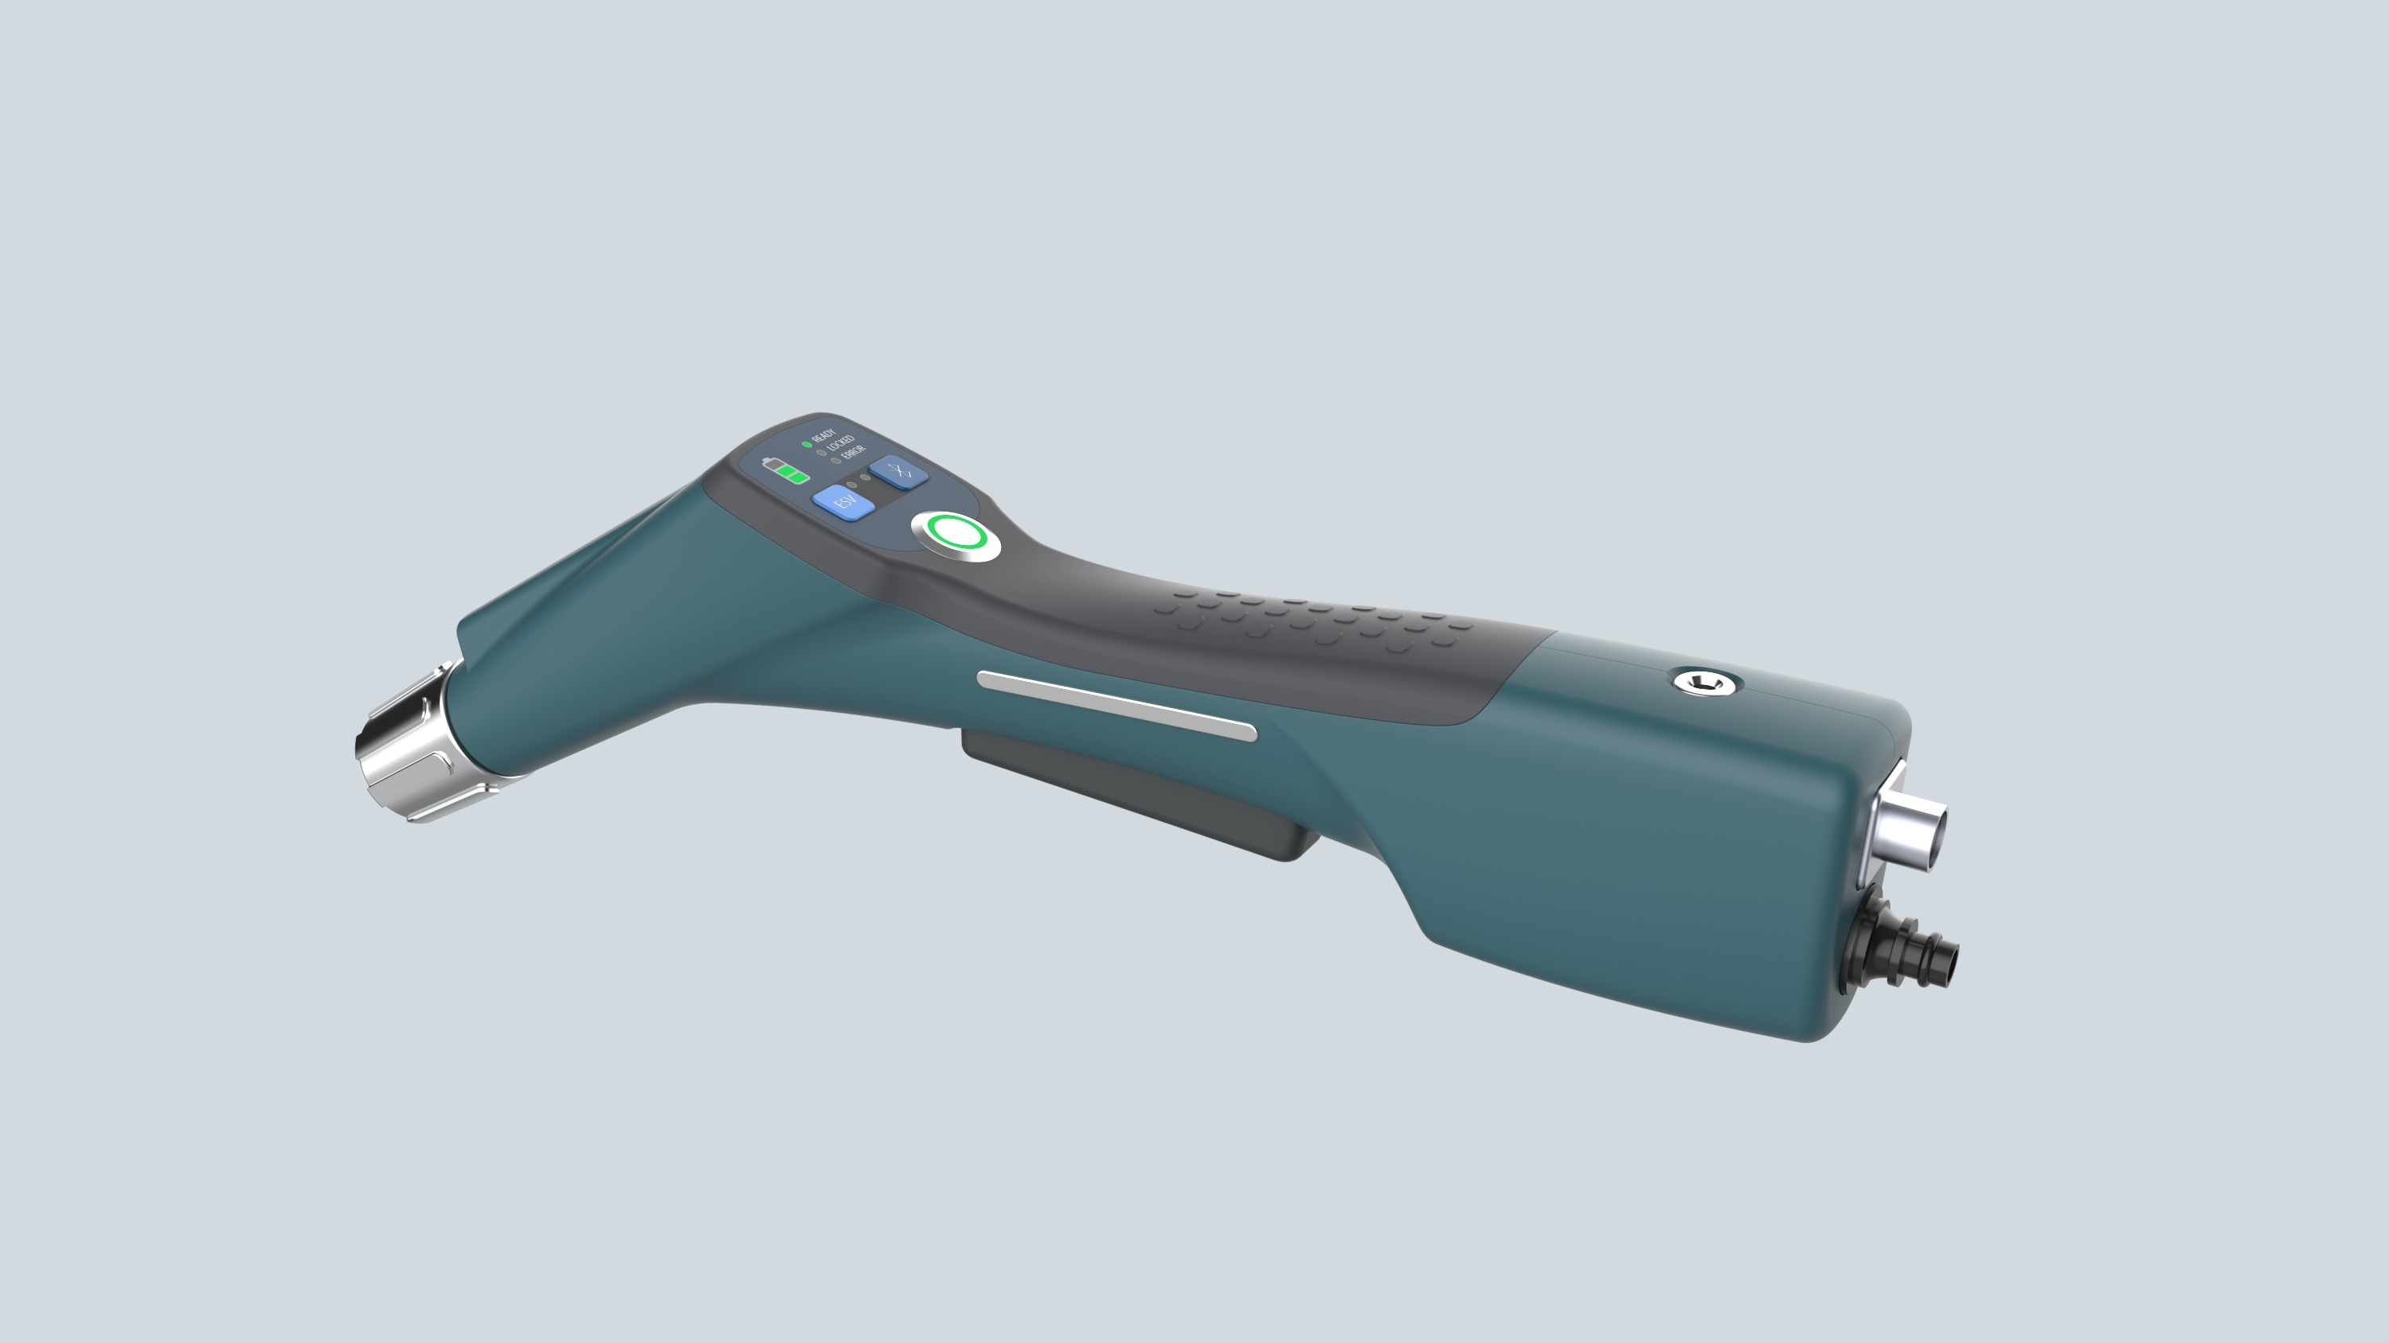
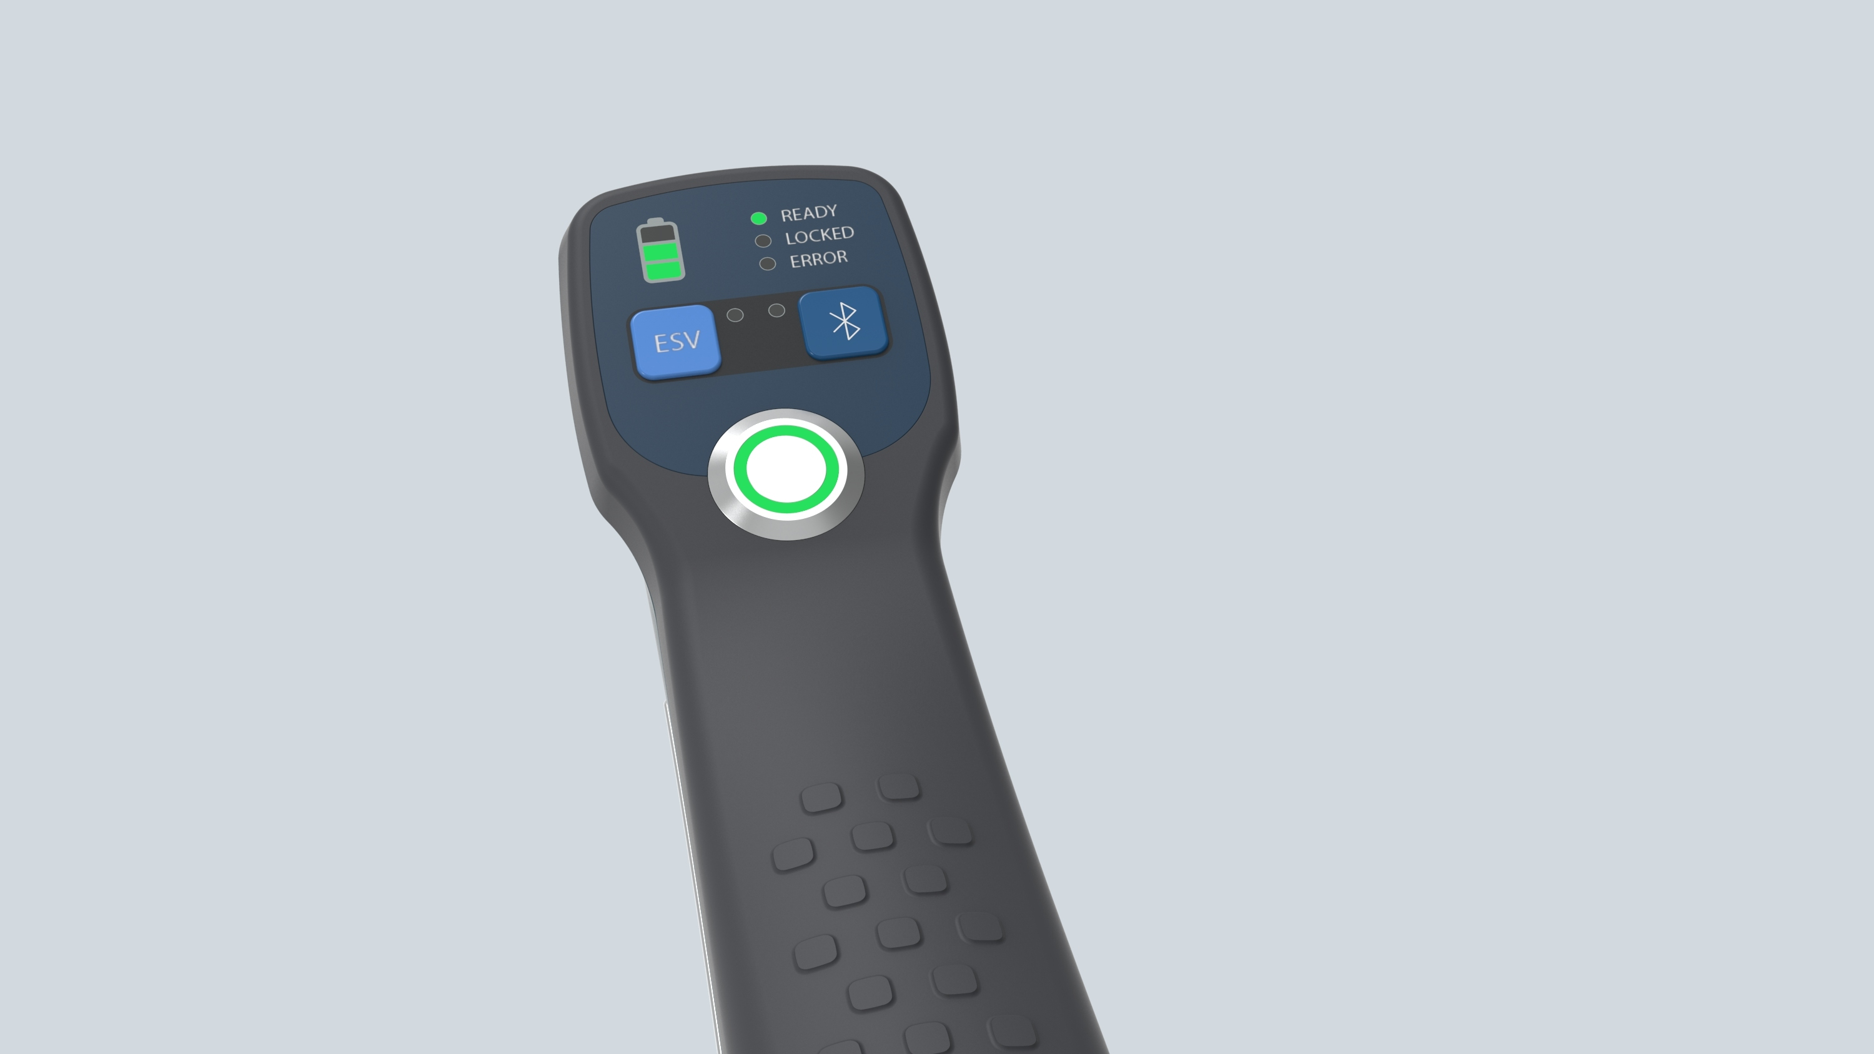
Previous Cockpit Concepts Archive

Slide 4

Concept A Wilson’s Winking Robot
Battery Status Four Segments 4 Green LEDS = 100% 3 Green = 75%
2 Yellow = 50%
1 Red = 25%
1 Flashing Red < 5%
Note: All buttons have a pad printed membrane with strong tactile feedback and an internal tri-color LED
Toggle Electrostatic
On – Green
Off – Flashing Red (reminder)
Toggle Bluetooth
On – Blue & Paired
Off – Blank & No Pairing
Discovery – Flashing Blue
Trigger Lock
Off – Green (default ready to spray)
On – Red (trigger cannot spray)
30% bigger surface area as used more often

Slide 5
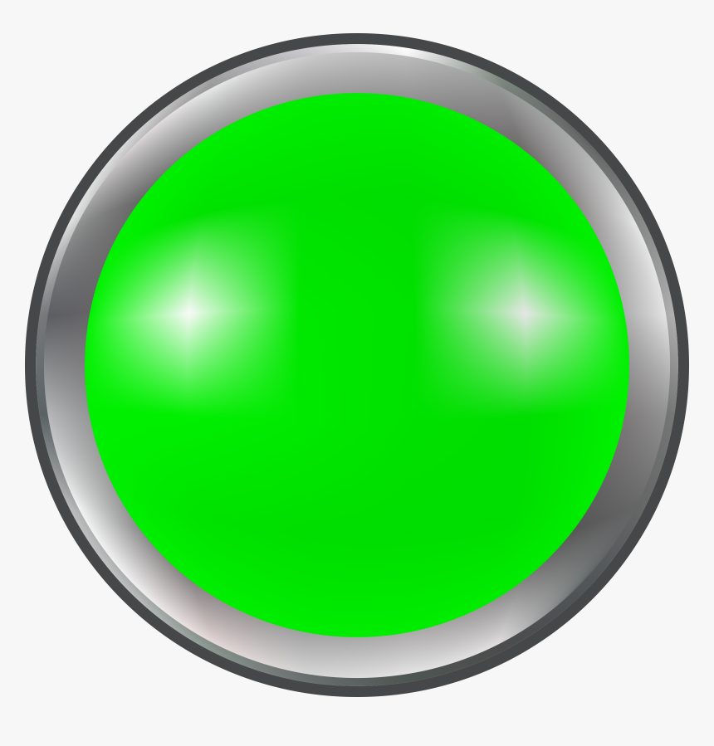
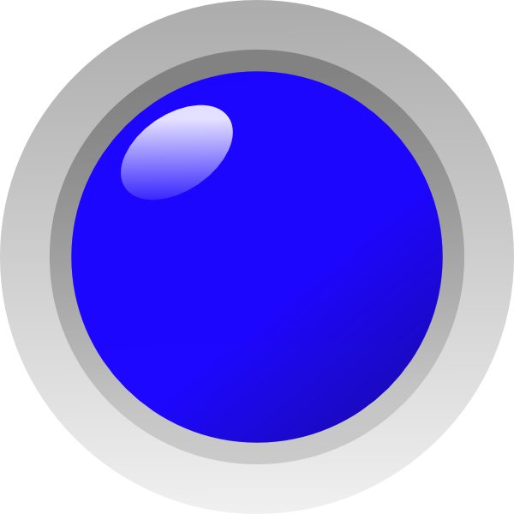
Concept B
Grid Layout
All buttons have the same function as described in Concept A but now they are:
Same size
Have dedicated bright LEDs clearly visible in daylight
Trigger Lock is right oriented like a gun safety for reaching easily with the (right hand) thumb…
6.5”
4”

